Slide 1









West African School on Air Quality and Pollution Prevention Summer School
Fieldwork, Community and School Engagement
AETHER GUARDIANS

Slide 2
OUTLINE
Introduction
Field Trips, Community and School Engagement
Survey Insights
AQ Pollutant Analysis
Recommendation and Conclusion

Slide 3
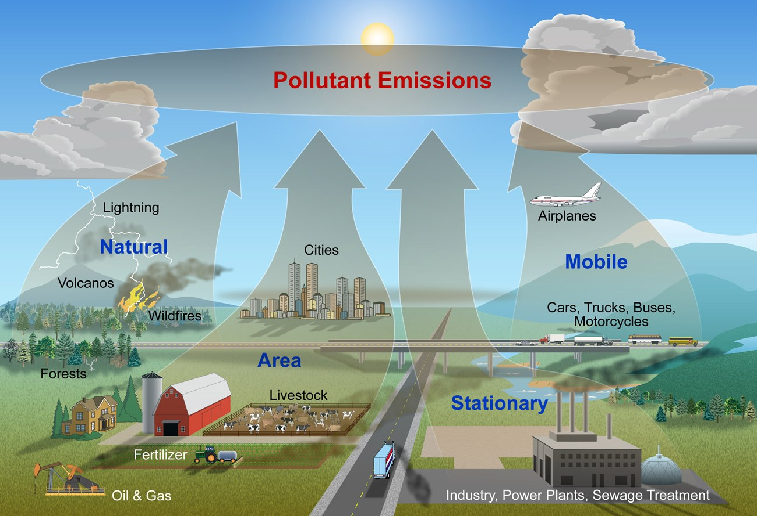
INTRODUCTION
Air pollution is one of the serious environmental problems throughout the world. Let's explore more deeply the sources of air pollution and how we can all play a role in keeping air clean for a better future.
In the past week, we have engaged in a number of tasks, from data visualization using R, listening to presentations on air quality, community engagement and even field survey on air quality.
Our Presentation will highlight some of these activities and the lessons learnt.

Slide 4


Kumasi Compost and Recycling Plant (KCARP)
Kumasi Compost and Recycling Plant (KCARP), a mega-scale municipal solid waste treatment plant, located at in the Bosomtwe District of the Ashanti region.
The plant founded in 2018 to receive and treat municipal solid waste from the Kumasi Metropolis and other communities in the region.
The plant received 1200 mega tonnes of wastes daily. The wastes received are referred to as raw materials.
Here, wastes received are processed into compost, plastic pellets, baled metals and cardboard, and refuse derived fuels for various end users.

Slide 5
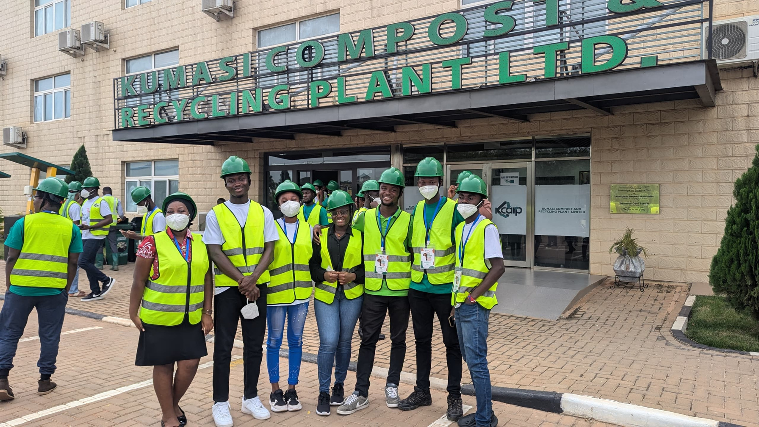
Kumasi Compost and Recycling Plant (KCARP)
Workplace Safety Practices At KCARP
• Regular safety training
• Regular equipment maintenance
• Good housekeeping
• Emergency procedures
• Regular safety inspections

Slide 6


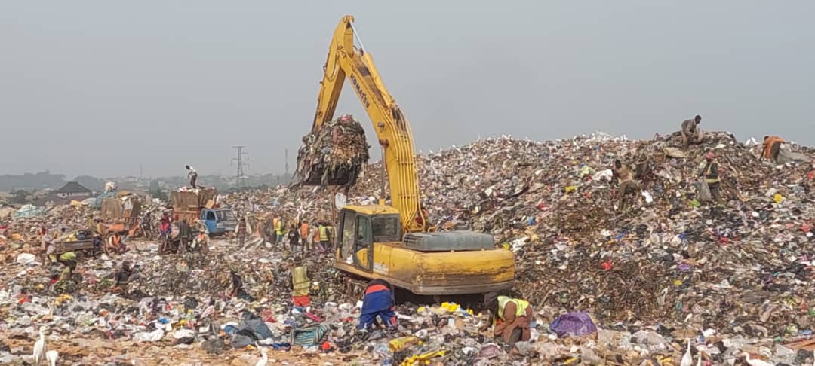
Oti Landfill Site, Kumasi
The Oti Landfill facility is the largest disposal site, receiving about 1,500 metric tonnes of wastes every day from Kumasi and its environs
This landfill site receives two types of wastes i.e. solid and liquid wastes.
This engineered landfill performs two functions;
• Groundwater protection
• Atmosphere protection

Slide 7
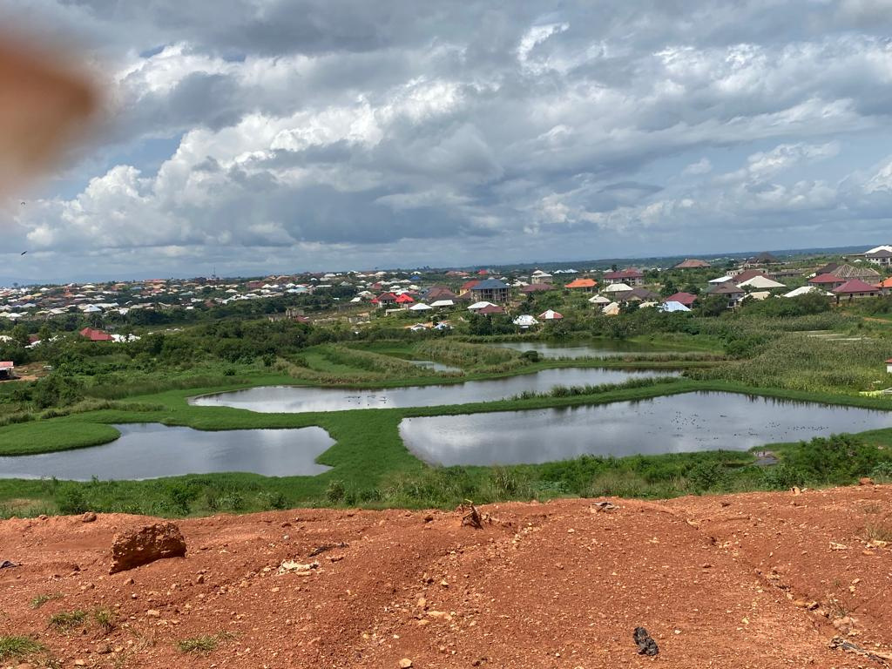
Oti Landfill Site, Kumasi
As a result of the volume of waste processed on a daily basis, Oti Landfill generates lots of pollutants which is not conducive for inhabitants who live close to the site and workers working to process the waste.
Challenges faced by the workers at Oti landfills:
Exposure to heat
Discomfort because of smell and dust coming from the waste deposited.
No provision of protective equipment.
No housing.

Slide 8
School Engagement
Aether Guardians embarked on a community engagement on air quality and pollution prevention at Kwame Nkrumah University of Science and Technology (KNUST) Junior High School to sensitize the students on air quality and pollution prevention.
Major highlights of the exercise were as follows;
• Teaching the students on air pollution
• Questions and answers’ sections
Major takeaways from the engagement with students of Junior High School
• The level of awareness of air pollution among the students were very high.
• The students were well informed about the various types of air pollutants.
• The students knew the various ways of preventing Air Pollution.

Slide 9
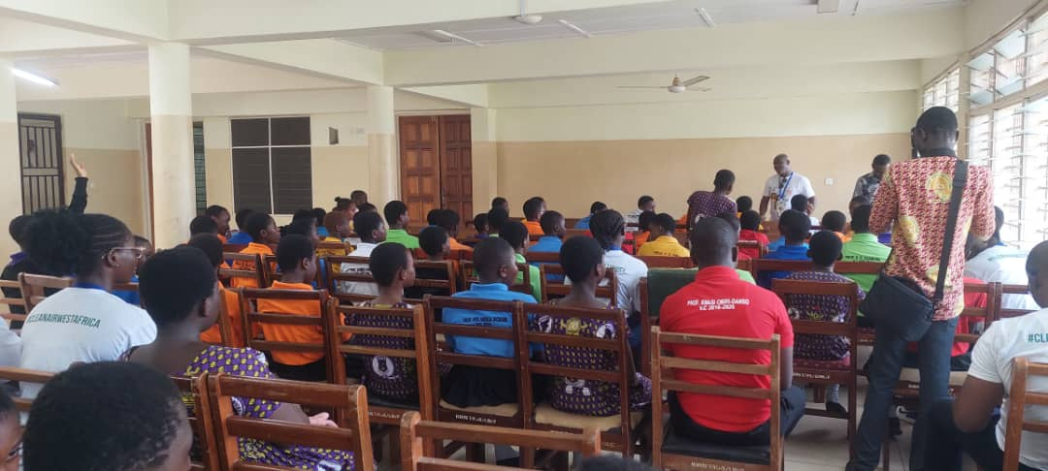
School Engagement

Slide 10

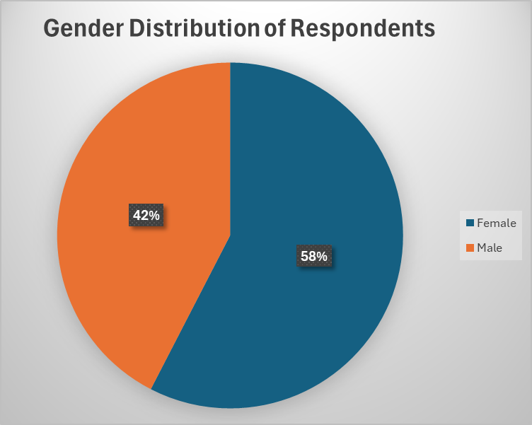
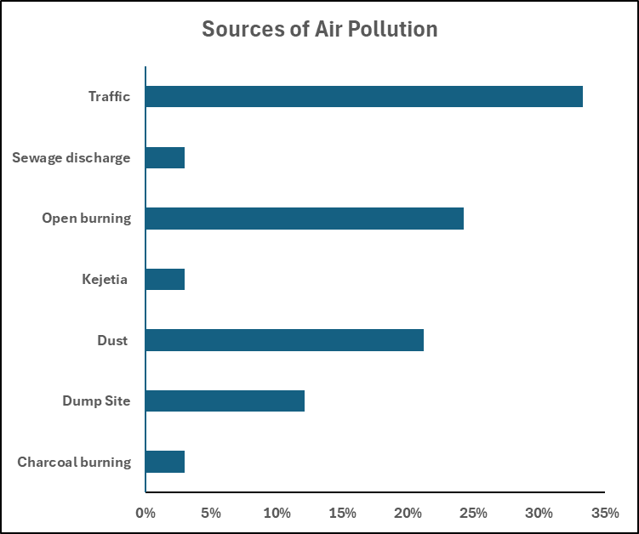

INSIGHTS FROM SURVEY
Study Area: Tech Junction and Oti Landfill, Kumasi, Ghana.
Sample size: 33 Respondents

Slide 11
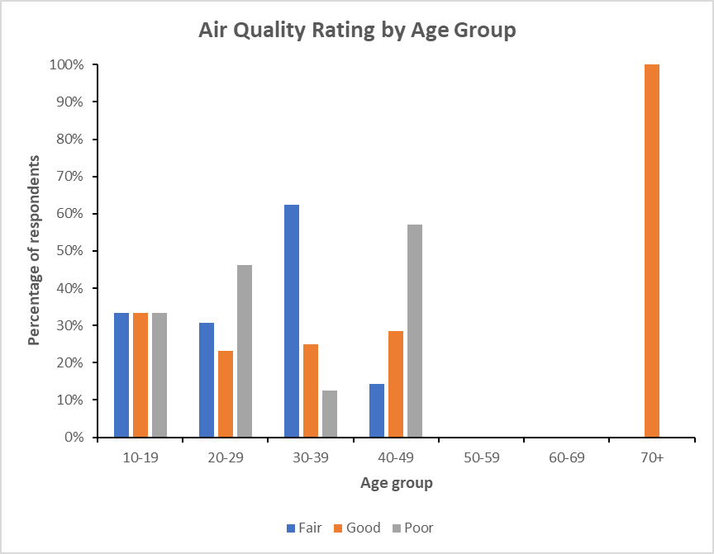
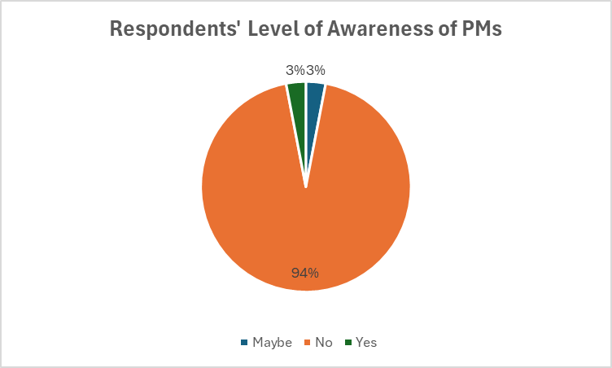
INSIGHTS FROM SURVEY

Slide 12
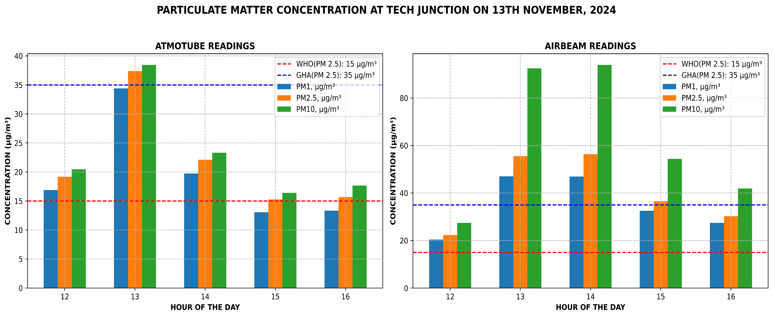
AQ POLLUTANTS ANALYSIS

Slide 13
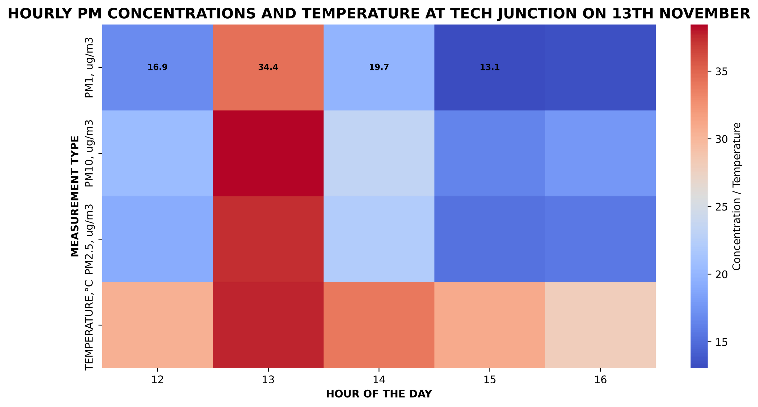
AQ POLLUTANTS ANALYSIS

Slide 14



Recommendations
Advocacy should be intensified nationwide and across the subregion.
Inclusion of all stakeholders to fight against air pollution.
Provision of Personal Protective Equipment for workers at the Landfills across West Africa.
Provision of Low-cost Air Quality Monitors within communities

Slide 15
Conclusion
Improving air quality in West Africa should be a collective effort among all countries to ensure cleaner and healthier environment.

Slide 16
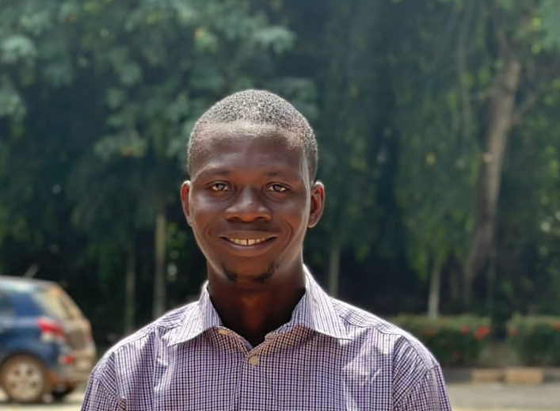



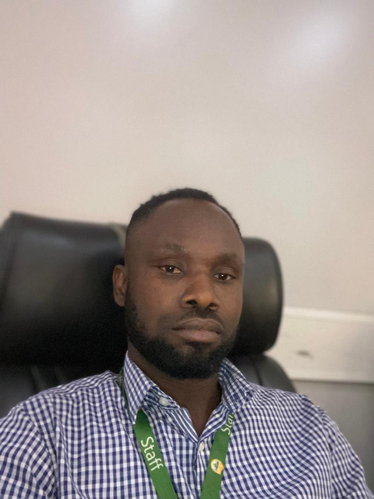

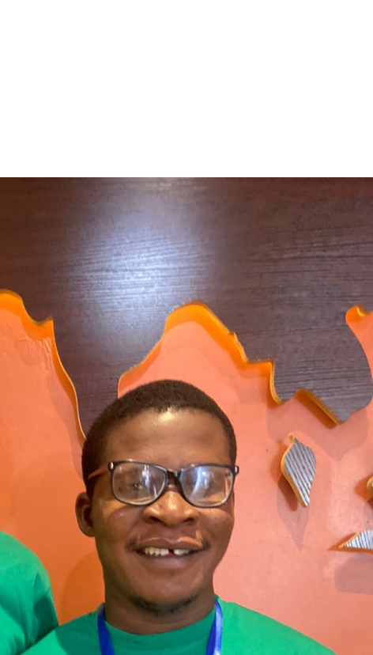
Oluwayomi
Daniel
Jonas
Sandra
Clement
Jesslyn
Fred

Slide 17
THANK YOU FOR LISTENING

